Slide 1
The Roles of Private Sector in Seed Sector Development
Samarendu Mohanty
International Rice Research Institute
s.mohanty@irri.org

Slide 2
Rice Sector Transformation
Farm level
Consumer level
Mechanization
Feminization
Virtual land
Consolidation
Branding
Quality upgradation
Healthier and nutritious rice
Vertical integration
Off-farm
opportunities
Outmigration
Aging farmers
Sustainability
(land and water)
Population growth
Income growth
Urbanization
Diversification

Slide 3
Innovative Models of Land Consolidation
“Small Farmer Large Field” Scheme in Vietnam
“Rice Commercialization” scheme in Suphan Buri, Thailand

Slide 4
Seed System Functions
Varietal development and release: primarily public sector
Seed multiplication and processing: private sector
Seed marketing and distribution: private sector

Slide 5
Enablers for commercial seed sector development
Strong agricultural market: Farmers have the opportunity to sell their produce
Strong public sector breeding program to develop new varieties
Public sector breeders should be connected to the demand and priorities of consumers
National and international research organizations must have mechanism to provide source seed to anyone who wants to multiply
Knowledgeable farmers and strong farm level seed management system
Supporting regulatory framework for seeds

Slide 6
Conducive environment for private sector involvement
Private sector access to breeding lines and improved seeds
Relaxing varietal release procedures and requirements
Provide equal footing to private sector enterprises
Encourage private sector, NGOs and contract growers to take up seed multiplication and processing

Slide 7
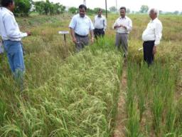
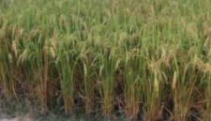
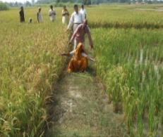
Strengthen seed systems & influence release strategies and regional policies to facilitate adoption and impact
Initiated through STRASA (Stress Tolerant Rice for Africa and South Asia)
Ten-year project funded by BMGF, covering 3 countries in S. Asia and 18 countries in Sub-Saharan Africa
Drought
Floods
Salt stress

Slide 8
Mobilizing partnership
Ensure ownership by national programs by aligning objectives with their priorities
Engage private sector in production and marketing of seeds of ST inbred varieties
Over 350 small and medium private seed producers involved
Over 15 large public and private sector seed companies and corporations
Strengthen public-private sector partnership (NSC of India and Nepal)-appropriate for inbred varieties
Challenge: supply of sufficient breeder and foundation seeds; information on market needs

Slide 9
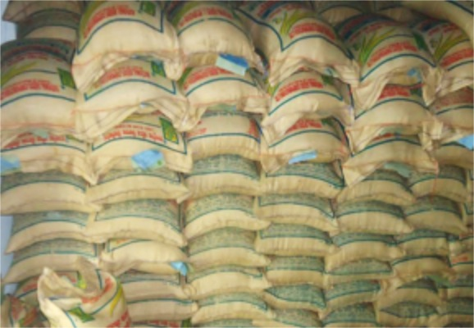
Estimate of Seed Produced in 2014
Available for use in 2015: 183,500 tons
Submergence tolerant varieties: 125,500 tons
Drought tolerant varieties: 42,750 tons
Salt tolerant varieties: 15,250 tons
Area coverage (@ 50 kg/ha) : 3.67 million ha
Estimates of farmers to be reached (0.45 ha/farmer): 8.0 million

Slide 10
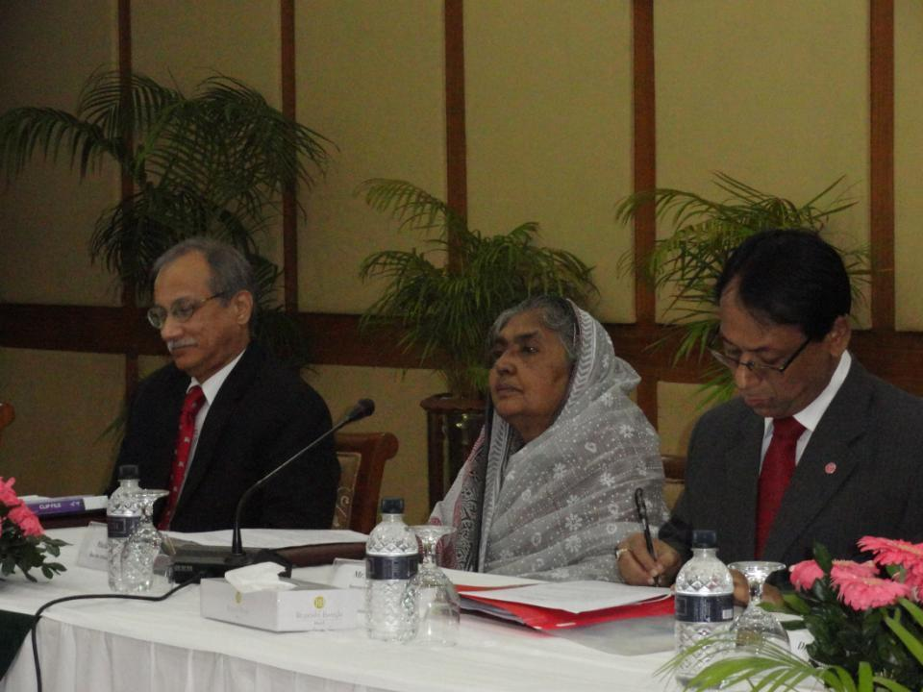
Bangladesh-India agreement signed on 17 February 2013
Joint varietal evaluation and release
Reciprocal recognition of evaluation data for varietal release
Reducing time for the evaluation of varieties released in neighboring countries for similar agroecologies
Acceptance of PVS data as primary data for varietal release
Prerelease seed multiplication & promotion
Encouraging private sector by providing level playing field
Harmonization of seed system
Germplasm exchange

Slide 11
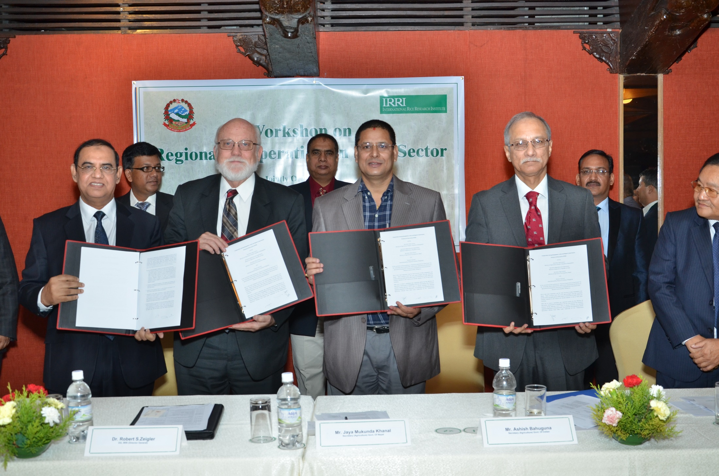
India-Bangladesh Agreement Extended to Nepal
(18 October 2014 )
Three countries agreed to share the evaluation data and varieties released in their respective countries for release and commercialization in the other two countries.

Slide 12
Outcome of the Agreement
India is in the process of notifying the following varieties released in Bangladesh: BINA dhan 8, BINA dhan 10, BINA dhan 11, & BINA dhan 12
Direct notification for WB, Assam, and Odisha
One-year evaluation for notification in other states
India is in the process of notifying the following varieties released in Nepal:
Sukha dhan 5 & Sukha dhan 6
Direct notification for UP and Bihar
One-year evaluation for notification in other states

Slide 13
Further expansion of this tricountry agreement to include Myanmar
IRRI can facilitate the Secretarial level meeting either in New Delhi or Naypyidaw.

Slide 14
Thank You

